Slide 1



Group And Team
Presented By:
Shikshya Maharjan
Sonika Bohora
Siddhartha Shakya
This Photo by Unknown author is licensed under CC BY-NC.

Slide 2

Meaning of group
Two or more individuals (interacting and interdependent) who come together to achieve particular (common) goals.

Slide 3
Characterisitics of group
Collection of two or more people
Common goal or interest
Interaction and interdependent
Collective identity
A stable structure

Slide 4
Why to form a group?
Security
Affiliation
Goal achievement
Socialization of new employees
Decision making

Slide 5

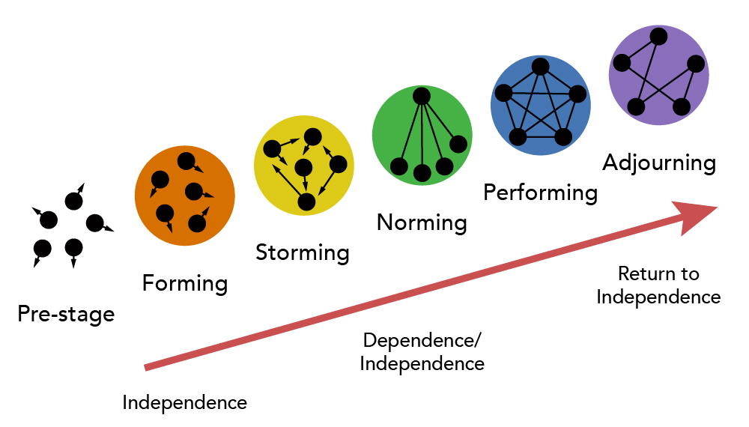
Stages of group formation
This Photo by Unknown author is licensed under CC BY.

Slide 6
Types of group
Formal Groups
Command groups
Task groups
Informal Groups
Interest groups
Friendship groups

Slide 7

Team
A group of the people working together towards a common goal. Generally speaking, a "team" is a collection of people who gather together to work cooperatively toward a similar purpose or objective.

Slide 8
IMPORTANCE OF TEAM
Attainment of common Goal
Accountability
Focus on goals
Creativity and communication
Participatory decision making
Interdependency

Slide 9


Group vs team
Work group
Work team

Slide 10
Group vs team
Bases of difference | Group | Team
Meaning | A group is a collection of individuals who are united by a common activity, interest, or characteristic. | A group of people working or participating together is referred to as a team.
Accountability | Individual accountability | Both individuals and mutual accountability
Decision making authority | Each group member has the authority to make decisions. | The team leader has the power to make decisions for the group.
Dependency | The members of the group are independent. | The members in the team are dependent.
Level of trust | The level of trust among the members is low. | The team members have a high degree of trust in one another.
Skills | Members of the group have a variety of odd talents. | Team member have complementary skills

Slide 11
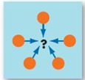
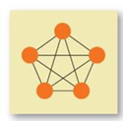
Types of team
Problem solving team:
Works together to tackle specific issues combining their skills, knowledge and ideas.
Self-managed team:
Group of people working together without traditional bosses.(takes responsibilities for their own work and make decisions

Slide 12
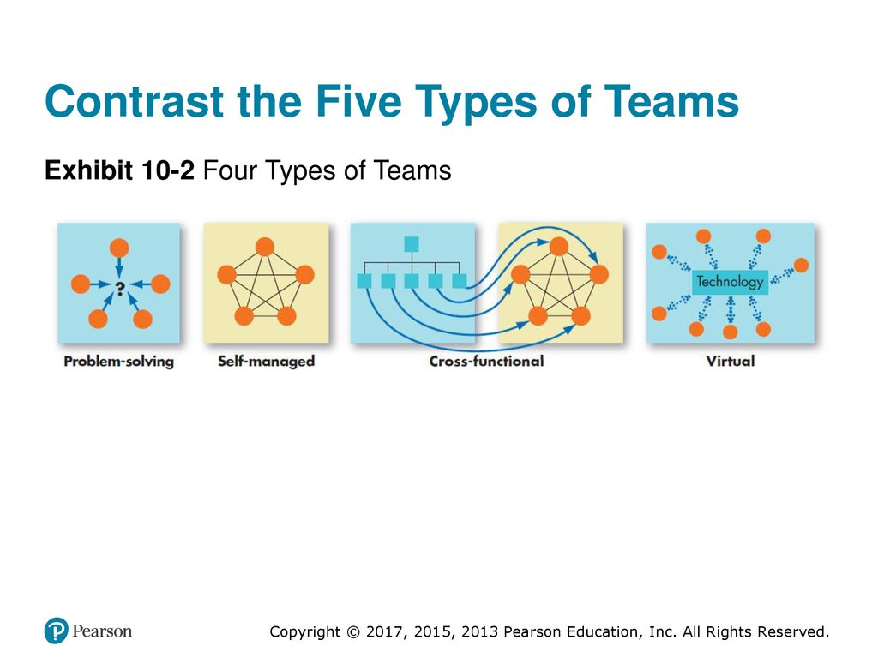
Types of team
Cross functional team:
Group of people from different departments working together.
Virtual team:
People from different places working together using it technologies and software technologies.

Slide 13

Organizational conflict

Slide 14

Concept of organizational conflict
Organizational conflict is a natural aspect of organizational life that arises due to differences in goals, values, or perspectives among members.
Understanding its sources, dynamics, and potential impacts is crucial for effectively managing conflict and leveraging it as a catalyst for organizational growth and development.

Slide 15
Managing Team Conflict
Managing team conflict
Stimulating Task Related Conflict
Minimizing Relationship Conflict
Managing Inter Personal Conflicts

Slide 16
Stimulating task-related conflict
Encourage Diverse Perspectives: Bring together team members with different backgrounds, expertise, and viewpoints.
Assign Ambiguous Tasks: Give team members tasks or projects with open-ended goals or vague guidelines.
Promote Devil's Advocacy: Encourage team members to play the role of devil's advocate during discussions and decision-making processes. This means deliberately challenging ideas and proposals to uncover potential flaws and stimulate constructive debate.
Use Competing Goals: Introduce conflicting goals or priorities within a project or task. For example, one goal might prioritize speed while another prioritizes quality.

Slide 17
Minimizing Relationship Conflict
Establish Clear Communication Channels: Ensure that there are open and transparent communication channels within the team or organization.
Promote Active Listening: Train team members in active listening techniques, such as paraphrasing and summarizing, to improve communication.
Clarify Roles and Responsibilities: Clearly define each team member's roles, responsibilities to minimize conflicts from misunderstandings.
Encourage Empathy and Respect: Encourage team members to consider others' perspectives and feelings before responding or taking action.

Slide 18
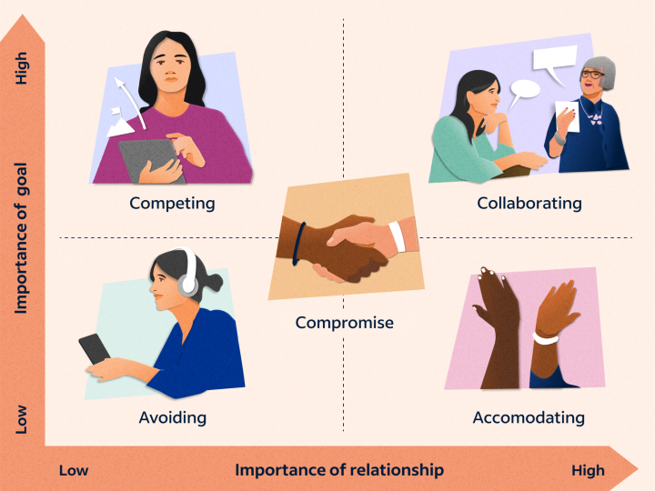
Managing Inter Personal Conflicts

Slide 19
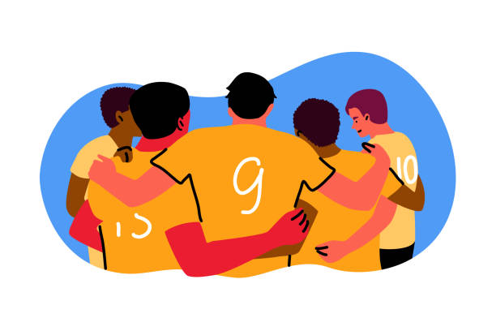


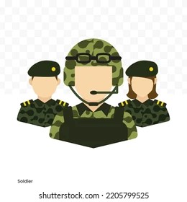
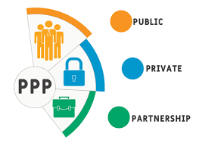

Position of teamwork in Nepalese organization
1. Sport sector
2. Government sector
3. Private sector
4. Army/Police
5. Public private partnership
6. Public enterprises

